Slide 1
A+ All About Motherboards
Notes:
1

Slide 2
What you need to know when finished
Learn about the different types and features of motherboards
Learn how to use setup BIOS and physical jumpers to configure a motherboard
Learn how to maintain a motherboard
Learn how to select, install, and replace a motherboard

Slide 3
Motherboard Types and Features
Motherboard
Most complicated computer component
One of the first items to consider when building a computer
Consider the following when purchasing a motherboard:
Form factor
Processor socket and chipset
Buses and number of bus slots
Other connectors, slots, and ports

Slide 4
Motherboard Form Factors
Determines motherboard size, features
Compatible with power supplies, cases, processors, expansion cards
Most popular
ATX, MicroATX, and Mini-ITX
Mini-ITX is smaller than MicroATX and is also known as ITX
The following slides show examples of form factors and comparisons of sizes and hold positions of several form factors

Slide 5
Figure 3-3 A Mini-ITX motherboard

Slide 6
Table 3-1 Sockets for Intel processors used for desktop computers

Slide 7
Processor Sockets
Processor socket – determines which processors a board can support
Socket holds Intel or AMD processor
Sockets for Intel processors
Intel makes several Itanium and Xeon processors designed for servers

Slide 8
Processor Sockets
Sockets and processor use different methods to make contacts between them:
Pin grid array (PGA) socket
Pins aligned in uniform rows around socket
Land grid array (LGA)
Uses lands (pads) rather than pins
Examples of LGA sockets: LGA775 and LGA1366
Flip-chip land grid array (FCLGA) socket
Chip is flipped over so that the top of the chip is on the bottom and makes contact with the socket

Slide 9
Processor Sockets
Sockets and processor use different methods to make contacts between them (cont’d):
Staggered pin grid array (SPGA)
Pins staggered over socket
Squeezes more pins into a small space
Easily bent
Ball grid array (BGA)
Not really a socket
Processor is soldered to the motherboard

Slide 10
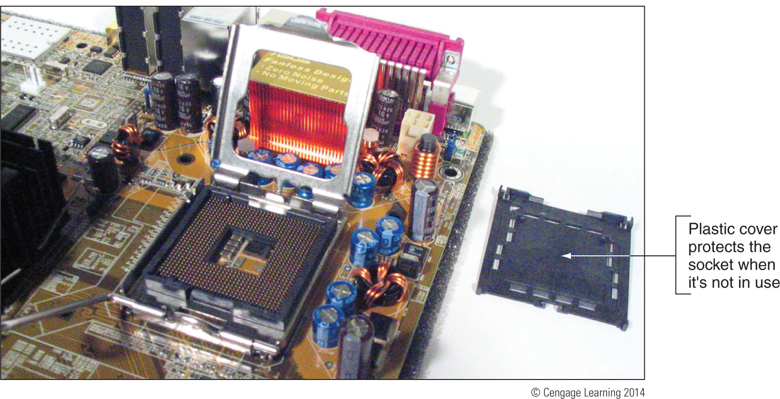
Figure 3-6 Socket LGA775 is the first Intel socket to use lands rather than pins

Slide 11
Processor Sockets
Zero insertion force (ZIF) sockets
All current processor sockets
Side lever lifts processor up and out of the socket
Sockets for AMD Processors
AMD uses the PGA socket architecture (desktops)

Slide 12
Table 3-3 Sockets for AMD processors used for desktop computers

Slide 13
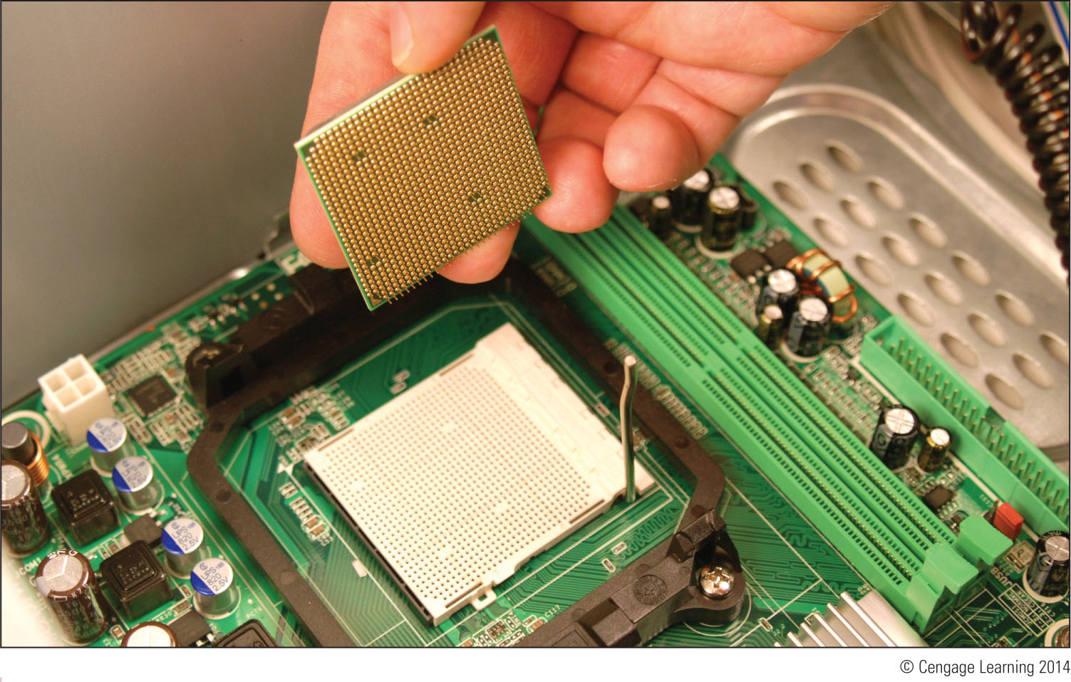
Processor Sockets
Match a processor to the socket and motherboard
Refer to motherboard, processor compatibility documentation
Figure 3-9 AMD Athlon 64 processor to be inserted into an AM2+ socket

Slide 14
The Chipset
Chipset: set of chips on motherboard that work with processor to collectively control:
Memory, motherboard buses, some peripherals
Manufacturers
Intel, AMD, NVIDIA, SiS, and VIA
Intel Chipsets
North Bridge and South Bridge - Uses hub interface
All I/O buses (input/output buses) connect to hub
Hub connects to system bus
North Bridge – fast end of hub
South Bridge – slow end of hub

Slide 15
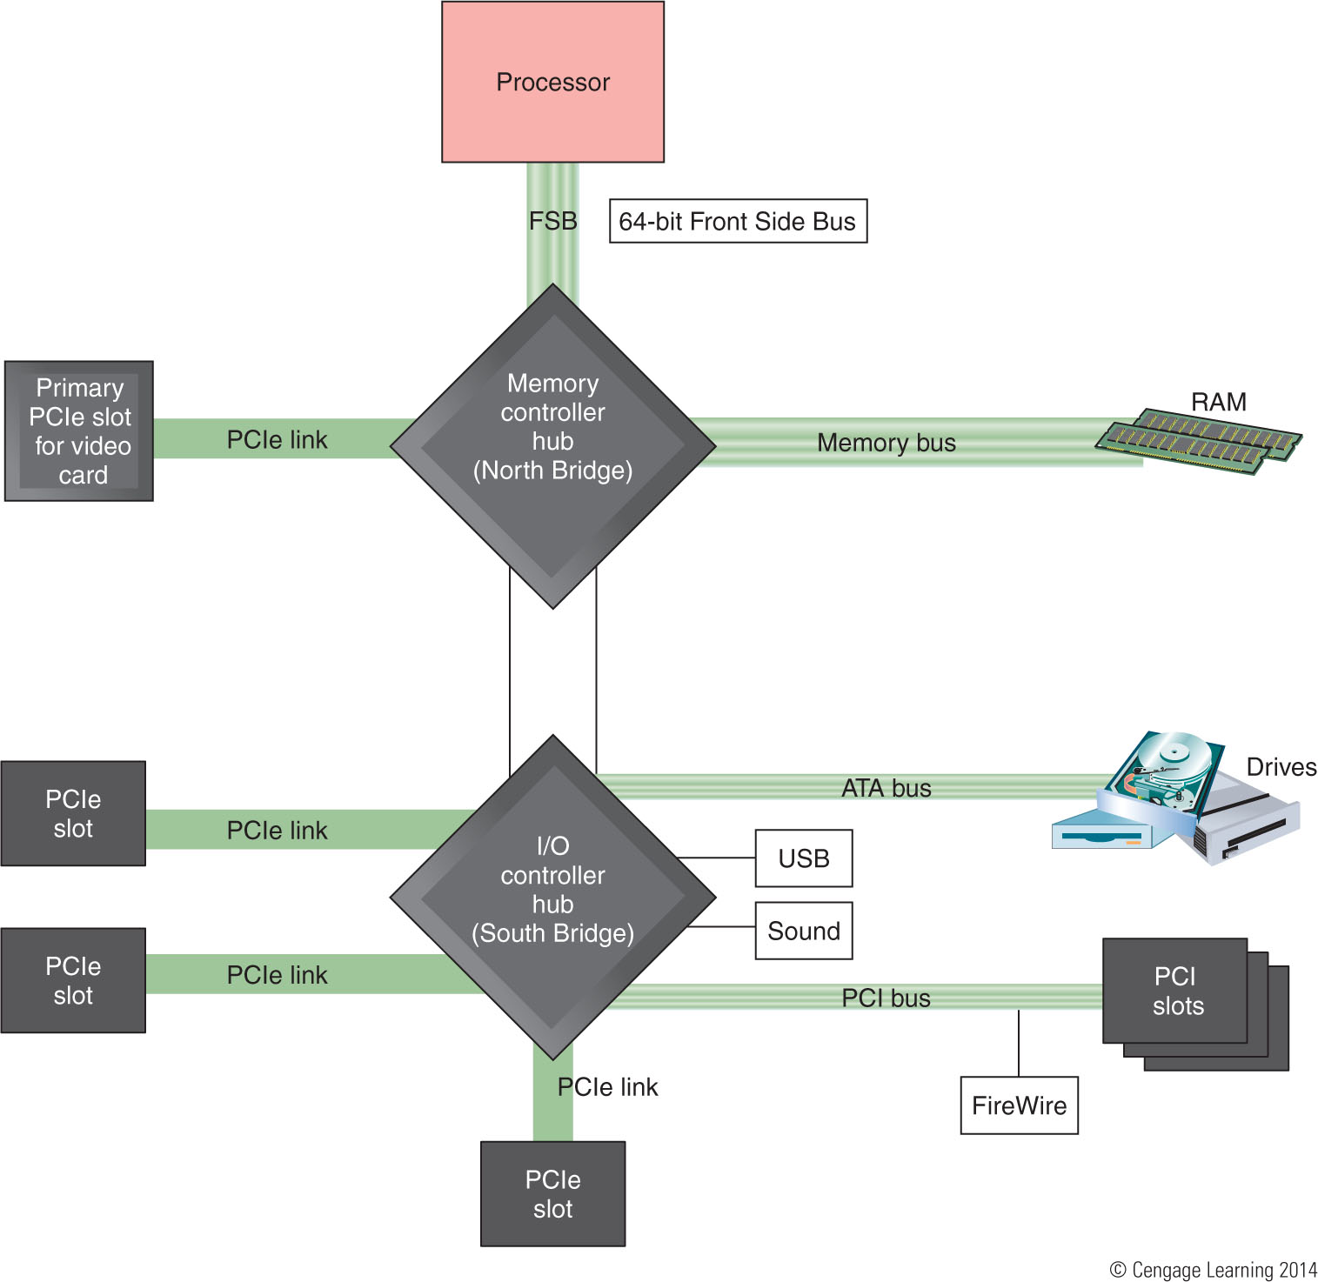
Figure 3-10 The chipset’s North Bridge and South Bridge control access to the
processor for all components

Slide 16
The Chipset
Intel Chipsets (cont’d)
Core i7 and X58 chipset
Referred to by Intel as Nehalem chipset
Contain memory controller within processor housing
Memory connects directly to processor
Has QuickPath Interconnect (QPI) technology
Has 16 lanes for data packets
Sandy Bridge chipset
Memory and graphics controller in processor
Second Generation Core i7 processor is an example
Sandy Bridge motherboards use DDR3 memory

Slide 17
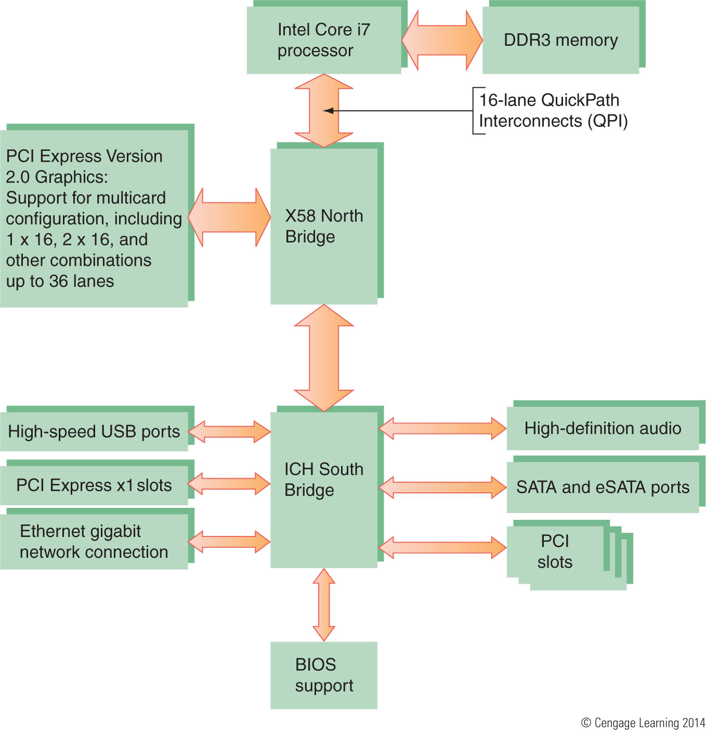
Figure 3-11 X58 chipset architecture

Slide 18
The Chipset
Intel Chipsets (cont’d)
Ivy Bridge chipset – 3rd generation processors released in 2012
Use less power
More transistors in a smaller place
Perform better than earlier products
Uses a single Platform Controller Hub

Slide 19
The Chipset
AMD chipsets
AMD A-series (code name Trinity)
Designed to compete with Ivey Bridge chipsets
AMD 9-series, 8-series, and 7-series
Designed for gamer, hobbyist, multimedia enthusiast
Focus on good graphics capabilities
Support overclocking
AMD 580X Crossfire chipset
Supports ATI CrossFire
AMD 780V chipset
Designed for business needs
AMD 740G and 690 chipsets
Designed for low-end, inexpensive systems

Slide 20
The Chipset
NVIDIA, SIS and VIA Chipsets
All make graphics processors and chipset for AMD and Intel processors
NVIDIA’s method of connecting multiple video cards is called SLI
If planning a gaming computer using two video cards:
Look for a motherboard that supports SLI and uses the nForce chipset

Slide 21
Buses and Expansion Slots
Bus
System of pathways used for communication
Carried by bus:
Power, control signals, memory addresses, data
Data and instructions exist in binary
Only two states: on and off
Data path size: width of a data bus
Examples: 8-bit bus has eight wire (lines) to transmit

Slide 22
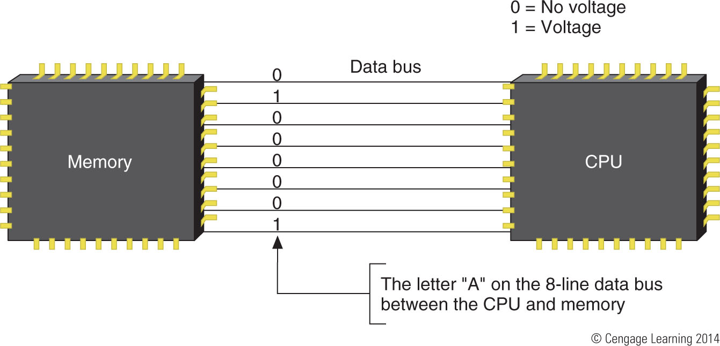
Figure 3-16 A data bus has traces or lines that carry voltage interpreted
by the CPU and other devices as bits

Slide 23
Buses and Expansion Slots
System clock (system timer) – times activities on the motherboard
Speed of memory, Front Side Bus, processor, or other component is measured in hertz (Hz), which is one cycle per second
Megahertz (MHz): one million cycles per second
Gigahertz (GHz): one billion cycles per second
Motherboards can have more than one bus
Table 3-4 on the following slide lists many buses

Slide 24
Table 3-4 Buses listed by throughput

Slide 25
Buses and Expansion Slots
Conventional PCI
Improved several times
Four types of slots and six possible PCI card configurations

Slide 26
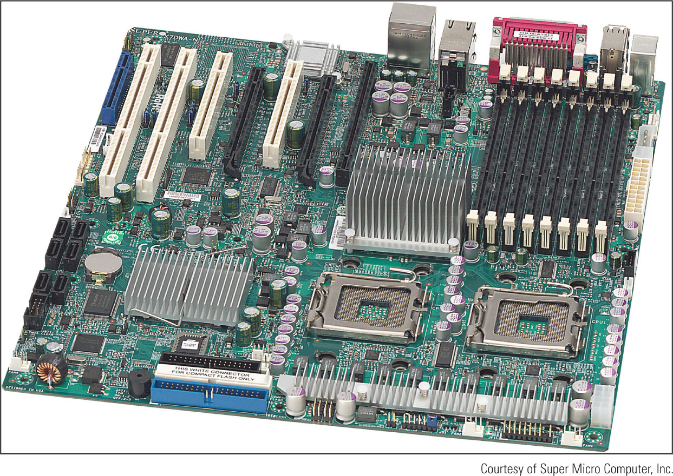
Buses and Expansion Slots
PCI-X
Uses 64-bit data path
Latest revision is PCI-X 3.0 (all revisions are backward-compatible)
Figure 3-19 The two long white
PCI-X slots can support PCI cards

Slide 27
Buses and Expansion Slots
PCI Express (PCIe)
Not backward compatible with conventional PCI or PCI-X
Expected to replace both PCI and PCI-X in the future
Uses a serial bus, which is faster than parallel
Comes in four different slot sizes
PCI Express x1, x4, x8, and x16
Latest version is PCIe 3.0 which doubles the throughput of version 2.0

Slide 28
Figure 3-21 Three types of PCIe slots and one conventional PCI slot

Slide 29
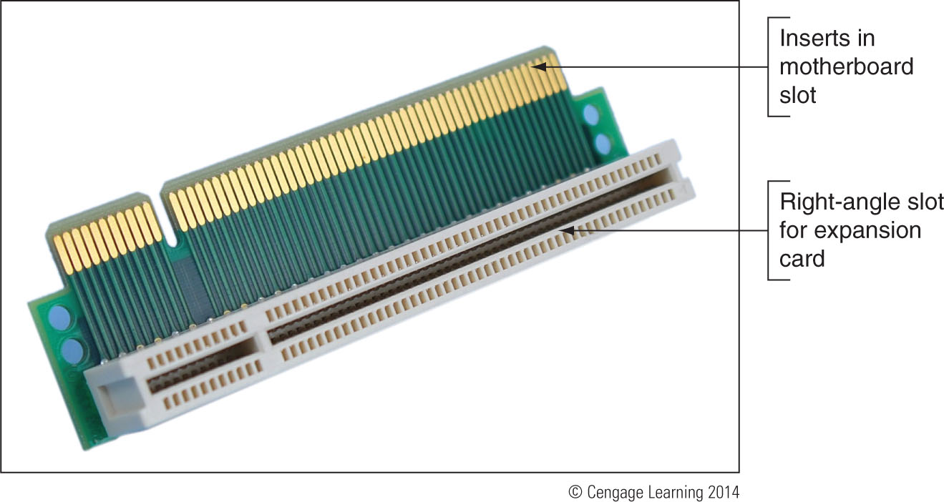
Buses and Expansion Slots
PCI Riser cards
Installs in a PCI slot and provides another slot at a right angle
Used to fit PCI, PCIe, and PCI-X cards into a low-profile or slimline case
Figure 3-23 PCI riser card provides a 3.3-V slot or 5-V slot depending on which direction the card is inserted in the PCI slot

Slide 30
Buses and Expansion Slots
AGP Buses
Accelerated Graphics Port (AGP) – standard used by motherboard video slots and video cards for years
Will need to know how to support it even though it is a dying technology
AGP standards include:
Three major releases - AGP 1.0, AGP 2.0, AGP 3.0
One major change in slot length – AGP Pro
Four different speeds – 1x, 2x, 4x, and 8x
Three different voltages
Six different slots

Slide 31
Table 3-5 AGP standards summarized

Slide 32
On-Board Ports and Connectors
On-board ports (integrated components)
Ports coming directly off the motherboard
USB, sound, network, video, eSATA ports
Older motherboards might have mouse and keyboard ports, parallel and serial ports
I/O shield
Plate installed in computer case providing holes for on-board ports
Internal connectors
Parallel ATA, floppy drive, serial ATA, SCSI, USB or FireWire (IEEE 1394) connectors

Slide 33
Configuring a Motherboard
Motherboard settings
Enable or disable connector or port
Set CPU frequency, system bus, other buses
Control security features
Control what happens when PC first boots
Three ways to configure older motherboards:
DIP switches, jumpers, CMOS RAM
Today, almost all motherboard configuration data is stored in CMOS RAM
Program called BIOS setup or CMOS setup is used to make changes to settings stored in CMOS RAM

Slide 34
Using Jumpers to Configure a Motherboard
Jumper – two small posts or metal pins that stick up off the motherboard that is open or closed
Open jumper has no cover and a closed jumper has a cover on the two pins
Retain setup or installation information
Jumpers can be used to clear a forgotten supervisor or power-on password

Slide 35
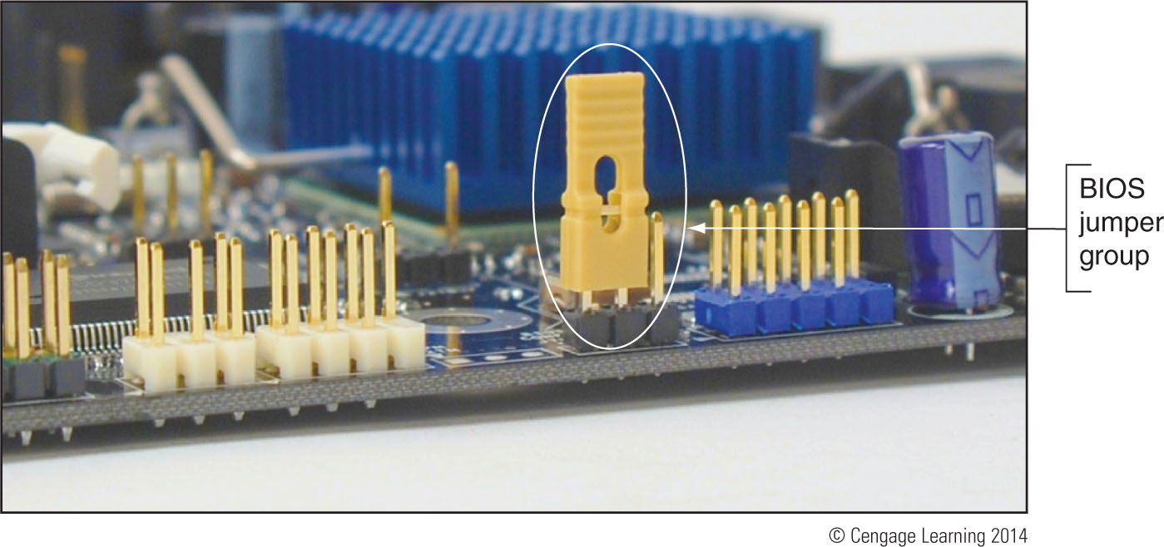
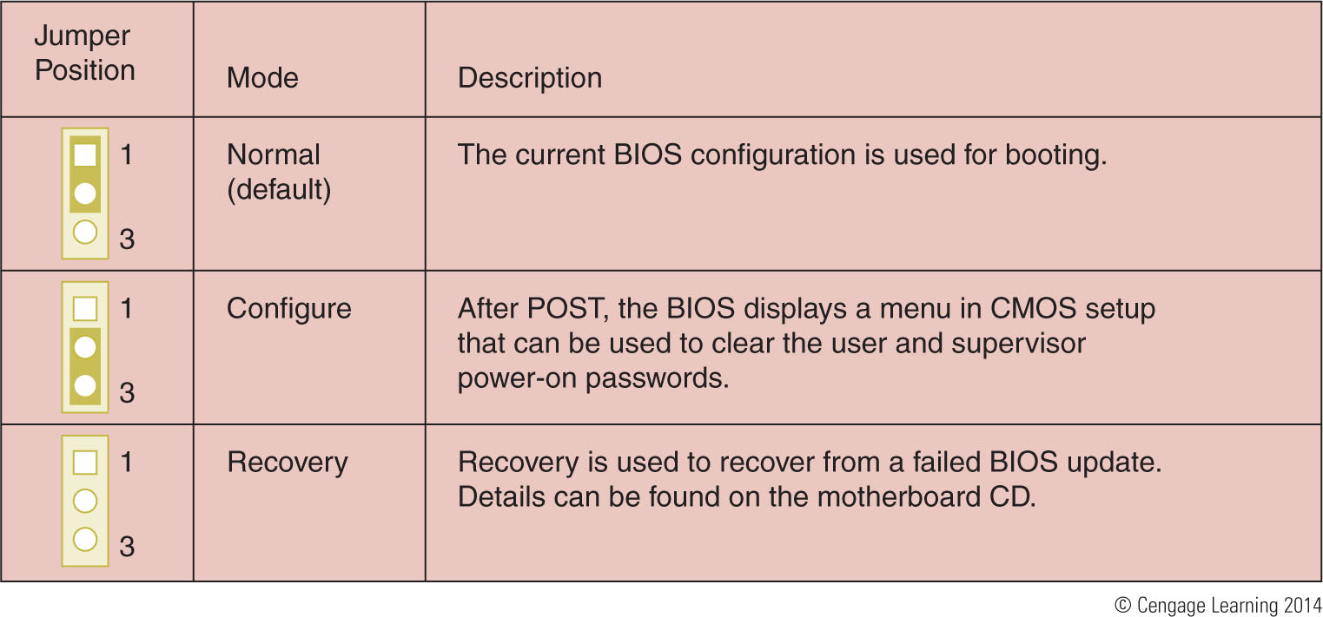
Figure 3-35 This group of three jumpers controls the BIOS configuration
Figure 3-36 BIOS configuration jumper settings

Slide 36
Using Setup BIOS To Configure a Motherboard
Access the BIOS Setup Program
Press a key or combination of keys during the boot process
Varies from one manufacturer to another
See documentation for your motherboard or watch the screen near the beginning of the boot
Setup screen appears with menus and Help features

Slide 37
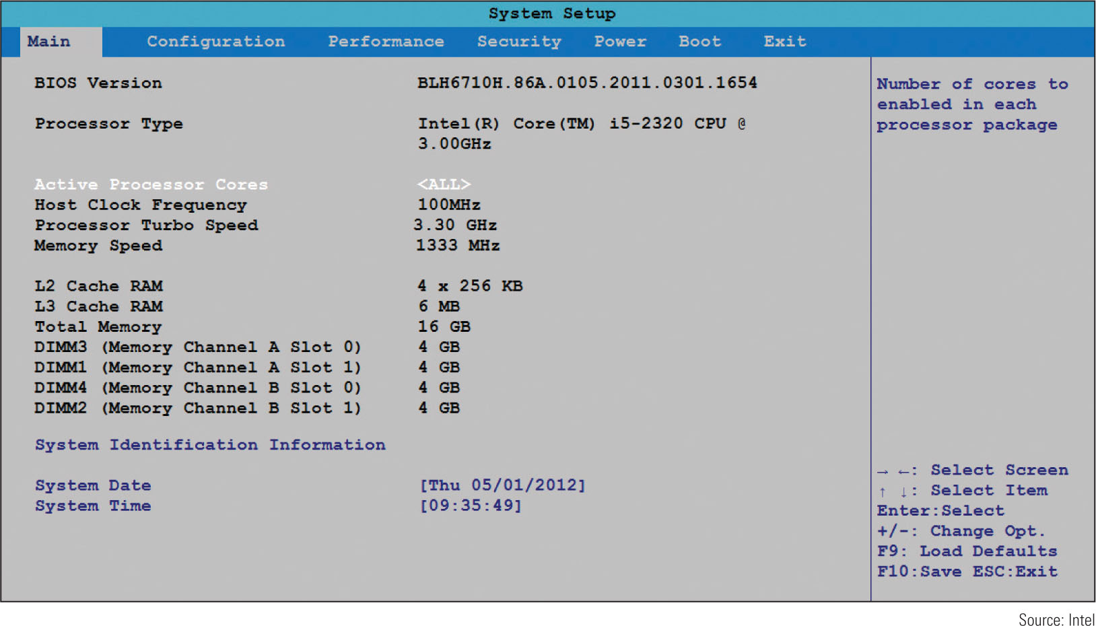
Figure 3-37 BIOS setup main menu

Slide 38
Using Setup BIOS To Configure a Motherboard
Change the boot sequence
Might need to change boot sequence from hard drive to DVD
Unified Extensible Firmware Interface (UEFI) – new standard slowly replacing BIOS
Interface between firmware on motherboard and the OS
Improves the boot process
UEFI is new boot option

Slide 39
Using Setup BIOS To Configure a Motherboard
Configure onboard devices
Enable/disable a port or group of ports
View hard drive and optical drive information
Processor and clock speeds
Some motherboards allow changing the processor speed and/or the memory multiplier
Monitor temperatures, fan speeds, and voltages
Intrusion detection
Can enable event logging (logs when case is opened)

Slide 40
Using Setup BIOS To Configure a Motherboard
Power-on passwords
Assigned in BIOS setup to prevent unauthorized access to the computer and/or BIOS setup utility
May be possible to set a supervisor and user password
If both passwords are set, must enter a valid password to boot the system
How to set passwords varies depending on motherboard and BIOS
Some allow a System power-on password, which will require a password be entered every boot
A Setup power-on password only requires a password be entered in order to access BIOS setup

Slide 41
Using Setup BIOS To Configure a Motherboard
LoJack
Technology embedded in the BIOS of many laptops to protect a system against theft
Must subscribe to service
Software and BIOS work together to locate a laptop whenever it connects to the Internet
Drive Encryption and Drive Password Protection
Some motherboards allow you to set a password in order to access the hard drive
Password kept on drive so that it still works even if drive is moved to another computer

Slide 42
Using Setup BIOS To Configure a Motherboard
TPM chip – Trusted Platform Module chip
BitLocker Encryption in Windows 7/Vista works with this chip
Encryption key is kept on chip
Assures that a drive cannot be used in another computer
Virtualization – when one physical machine hosts multiple activities that are normally on multiple machines
Virtualization must be enabled in BIOS setup for VM software to work

Slide 43
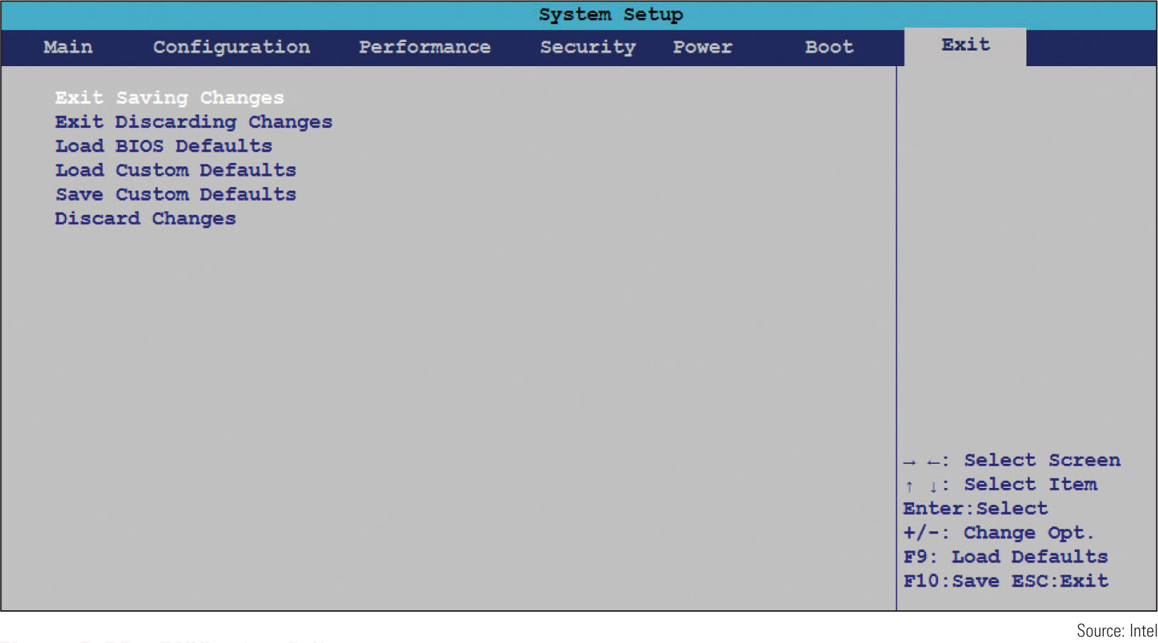
Using Setup BIOS To Configure a Motherboard
Exiting the BIOS setup menus
Most exit screens give several options
Figure 3-50 BIOS setup Exit menu

Slide 44
Maintaining a Motherboard
Motherboard is considered a field replaceable unit
Need to know how to:
Update motherboard drivers
Update flash BIOS
Replace CMOS battery

Slide 45
Maintaining a Motherboard
Update motherboard drivers
Device drivers are small programs that allow software to interact with certain hardware
Use Windows internal drivers, bundled CD drivers, or download drivers from manufacturer site
Flash BIOS
Process of upgrading or refreshing the ROM BIOS chip
BIOS updates are downloaded from motherboard manufacturer’s Web site or third party site
Performed if motherboard unstable, incorporating new feature, or component

Slide 46
Maintaining a Motherboard
Methods of installing BIOS updates
Express BIOS update
Update from a USB flash drive using setup BIOS
Update using a bootable CD
Recovery from a failed update
“If it’s not broke, don’t fix it” – only update if you’re having trouble with a motherboard
Don’t update unless the update is a later version than the one installed
Update should not be interrupted while in progress

Slide 47
Maintaining a Motherboard
Replacing the CMOS battery
Choose correct replacement battery
Power down system, unplug it, press power button to drain the power, remove case cover
Use ground bracelet, remove old battery using a flat-head screwdriver, pop new battery into place

Slide 48
Installing or Replacing a Motherboard
Consider the following when selecting a motherboard:
Form factor
The brand (Intel or AMD) and model processors the board supports
Chipset and memory speeds the board supports
Expansion slots (type and how many needed)
Hard drive controllers
Case
Price and warranty
Support

Slide 49
Installing or Replacing a Motherboard
General process for replacing a motherboard:
1. Verify right motherboard is selected
2. Get familiar with documentation, features, settings
3. Remove components to reach old motherboard
4. Set any jumpers on the new motherboard
5. Install the I/O shield (metal plate)
6. Install motherboard
7. Install processor and processor cooler
8. Install RAM
9. Attach cabling (case switches, power supply, drives)

Slide 50
Installing or Replacing a Motherboard
General process for replacing motherboard (cont’d.)
10. Install video card on motherboard
11. Plug in PC, attach monitor, keyboard
12. Boot system, enter BIOS setup
12. Verify settings set to default
Check time and date
Make sure abbreviated POST is disabled
Set the boot order
Leave everything else at defaults
Save and exit

Slide 51
Installing or Replacing a Motherboard
General process for replacing motherboard (cont’d.)
13. Observe POST, verify no errors
14. Verify Windows starts with no errors
15. Install the motherboard drivers
16. Install other expansion cards and drivers
17. Verify system operating properly, make final OS and BIOS adjustments (setting power-on passwords)

Slide 52
Summary
The motherboard is the most complicated of all components inside a computer
Most popular motherboard form factors are ATX, MicroATX and Mini-ITX
Motherboard will have one or more processor sockets
Intel, AMD, NVIDIA, and SiS are the most popular chipset manufacturers
Major advancements in Intel: Accelerated Hub Architecture, Nehalem chipsets, Sandy Bridge and Ivy Bridge chipsets

Slide 53
Summary
Buses include conventional PCI, PIC-X, PCI Express, and AGP
Some components can be built into the motherboard, called on-board components
Most common method of configuring a motherboard is BIOS setup
Settings that can be changed include: changing boot order, enabling or disabling onboard devices, support for virtualization, and security settings

Slide 54
Summary
Motherboard drivers and/or BIOS might need updating to fix a problem
CMOS battery might need replacing
When selecting a motherboard pay attention to the form factor, chipset, expansion slots, memory slots, and processors supported
Study motherboard manual before installing it

